Slide 2
GitHUB
GitHub is a provider of Internet hosting for software development using Git.
It offers the distributed version control and source code management

Slide 3
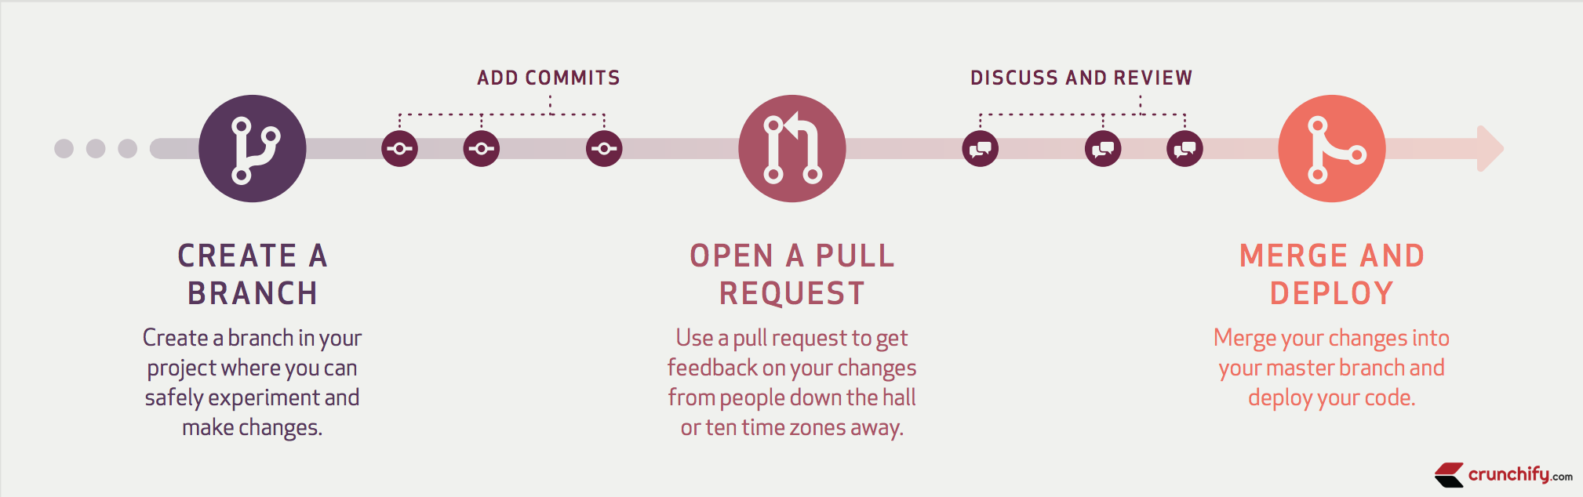
The GitHub flow

Slide 4
The GitHub flow
The GitHub flow has six steps, each with distinct benefits when implemented:
Create a branch: When you create a branch in your project, you're creating an environment where you can try out new ideas. .
Add commits: Once your branch has been created, it's time to start making changes. Whenever you add, edit, or delete a file, you're making a commit, and adding them to your branch

Slide 5
Open a pull request: Pull requests publicize a project’s ongoing efforts and set the tone for a transparent development process.
Discuss and review code: Teams participate in code reviews by commenting, testing, and reviewing open pull requests. Code review is at the core of an open and participatory culture.

Slide 6
Merge: Upon clicking merge, GitHub automatically performs the equivalent of a local ‘git merge’ operation.
Deploy: Teams can choose the best release cycles or incorporate continuous integration tools and operate with the assurance that code on the deployment branch has gone through a robust workflow.

Slide 9
Software quality
Software quality is defined as a field of study and practice that describes the desirable attributes of software products.
There are two main approaches to software quality:
Defect management
Quality attributes.

Slide 10
Software Quality Defect Management Approach
A software defect can be regarded as any failure to address end-user requirements.
Common defects include missed or misunderstood requirements and errors in design, functional logic, data relationships, process timing, validity checking, and coding errors.

Slide 11
The software defect management approach is based on counting and managing defects.
Defects are commonly categorized by severity, and the numbers in each category are used for planning.
More mature software development organizations use tools, such as defect leakage matrices to measure and improve development process capability.

Slide 12
Software Quality Attributes Approach
This approach to software quality is best exemplified by fixed quality models, such as ISO/IEC 25010:2011.
This standard describes a hierarchy of eight quality characteristicS

Slide 13
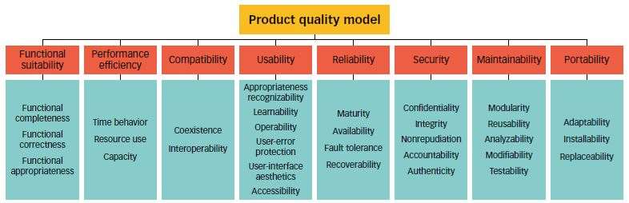

Slide 14
Functional suitability
Reliability
Operability
Performance efficiency
Security
Compatibility
Maintainability
Transferability

Slide 15
6/12/21 absent 2 8 11 16 17 18 22 25 59

Slide 16
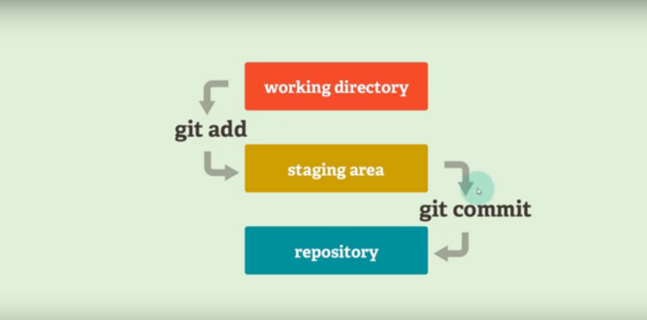

Slide 17
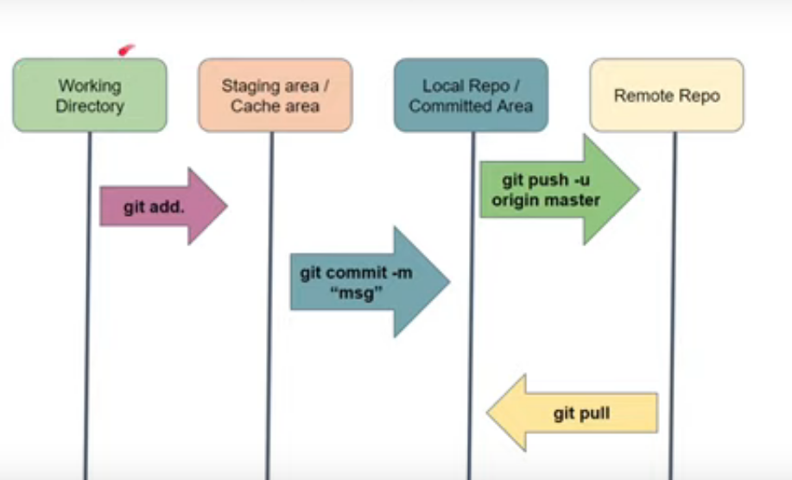

Slide 18
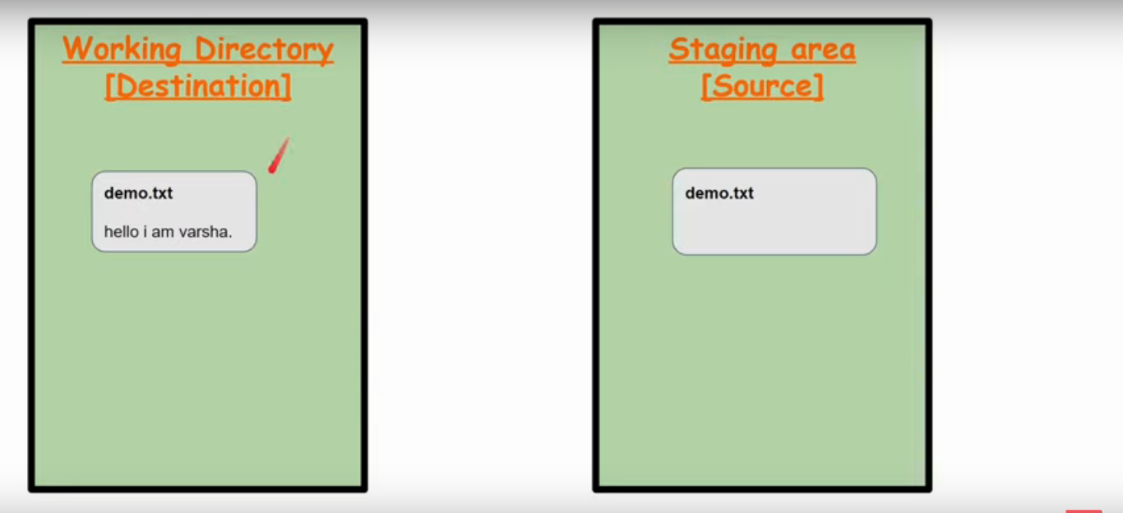

Slide 19
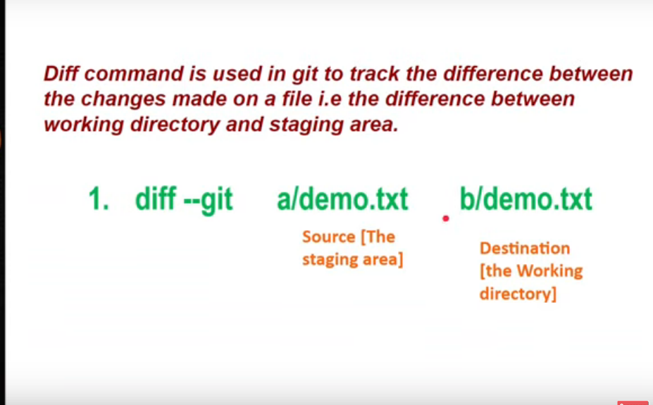

Slide 20
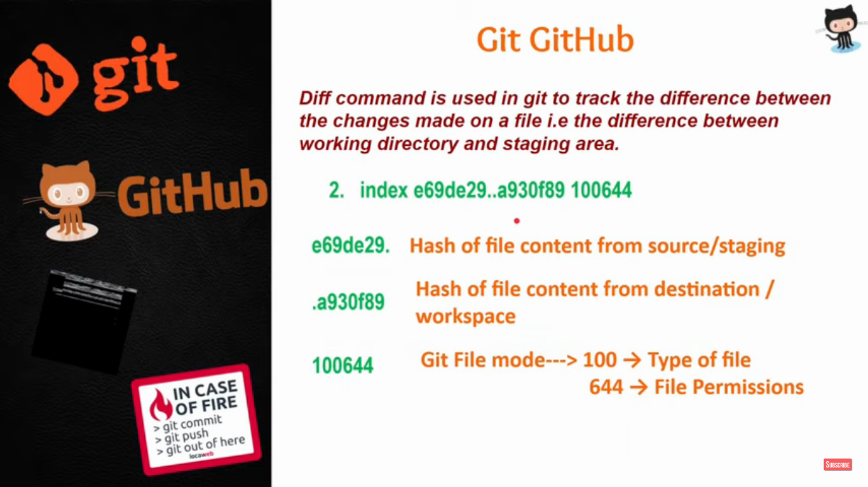

Slide 21
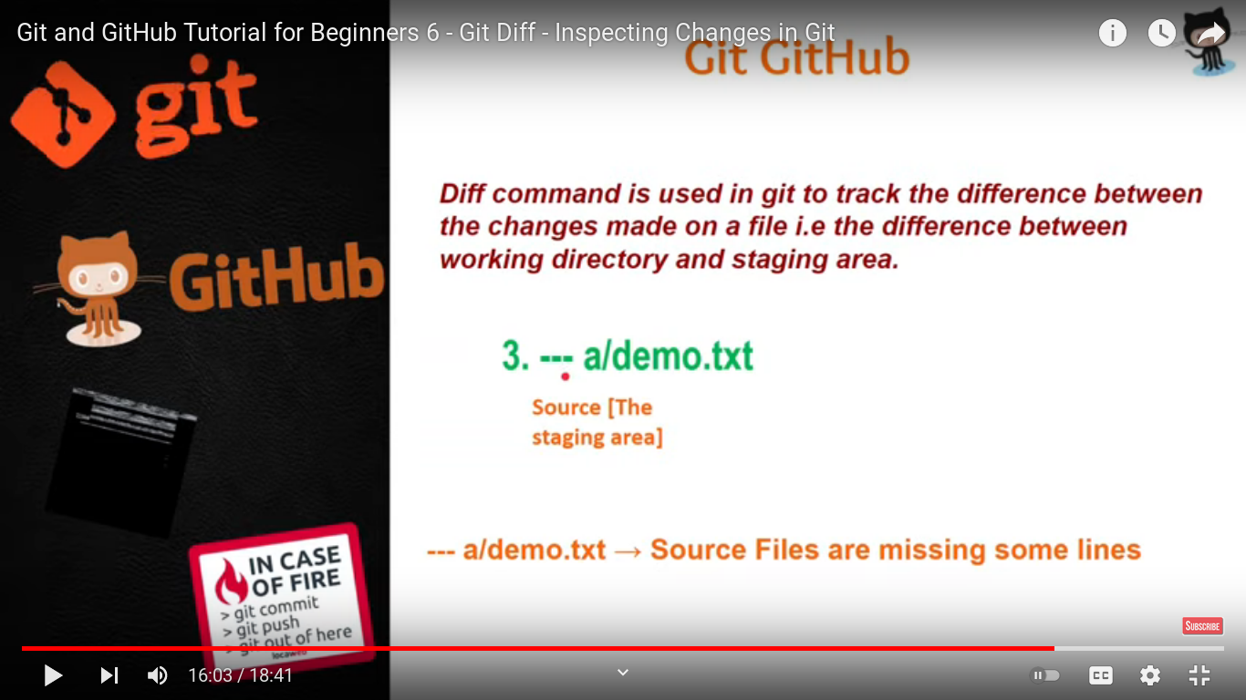

Slide 22
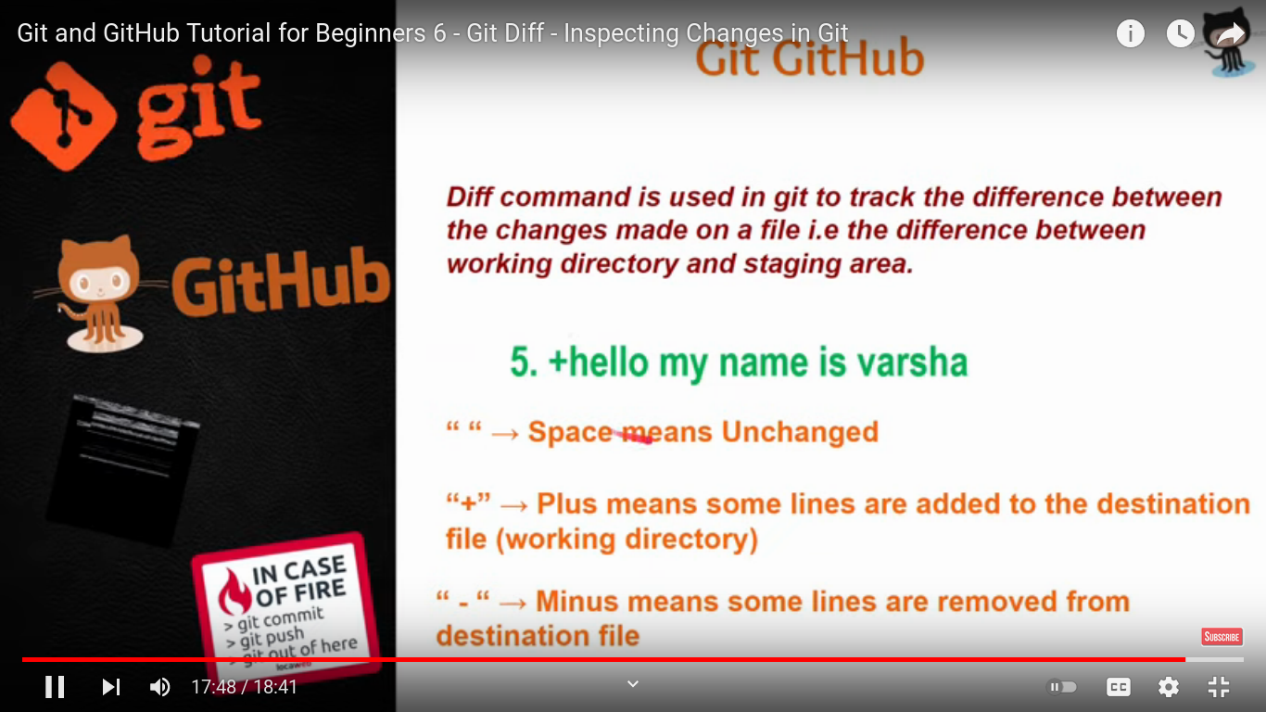

Slide 23
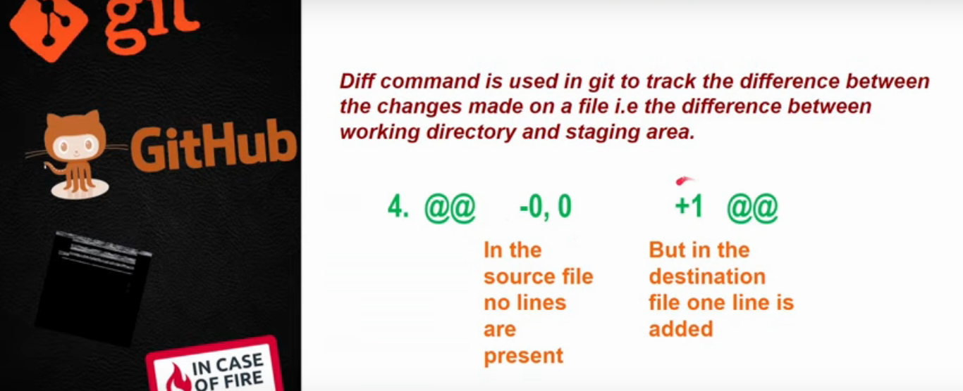

Slide 25
